Slide 1
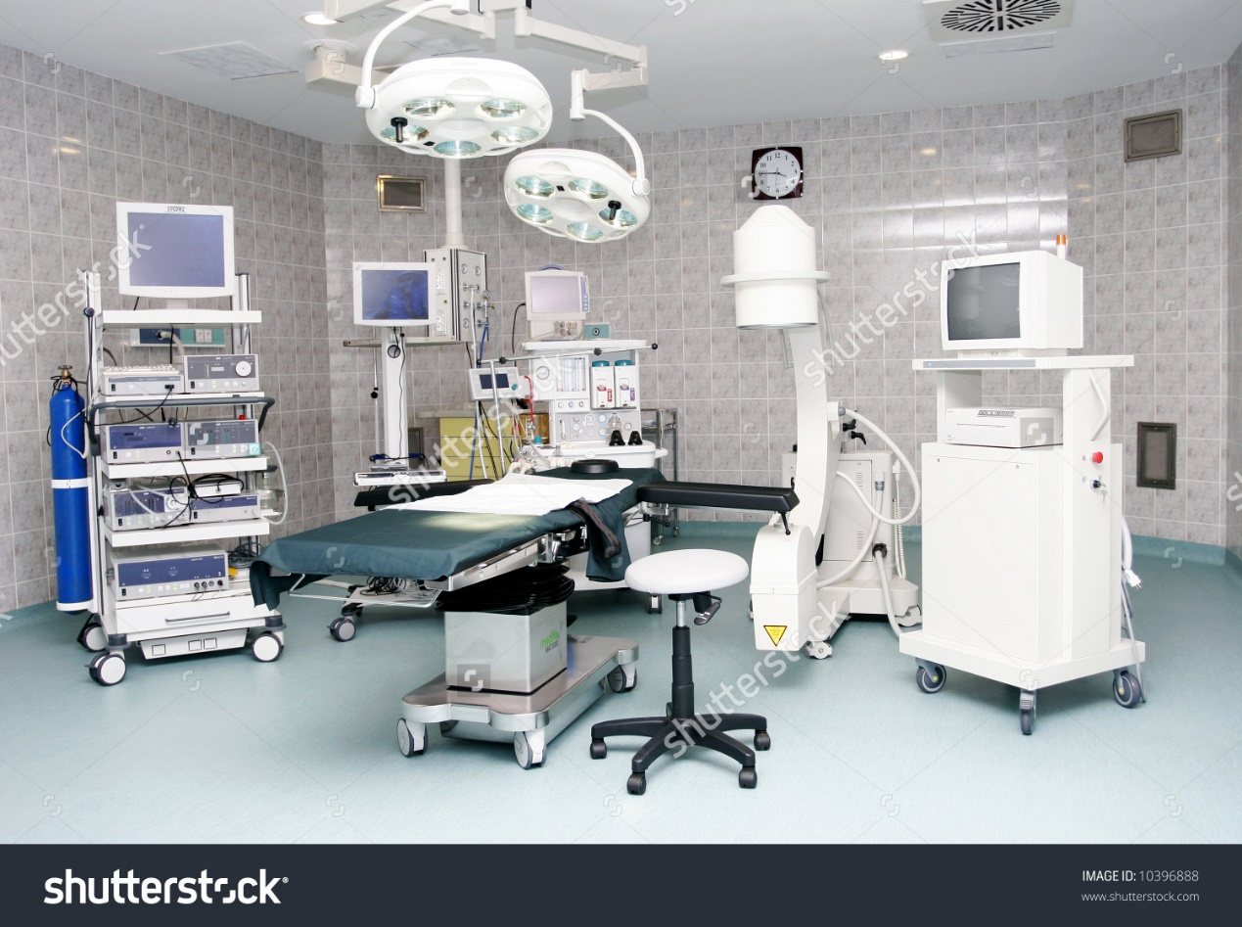
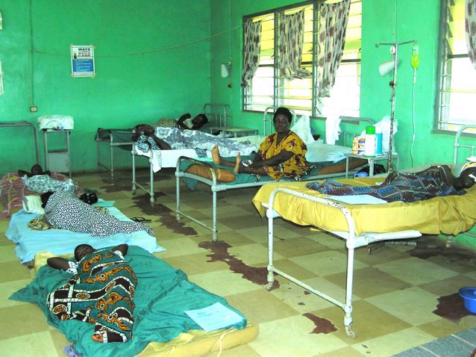
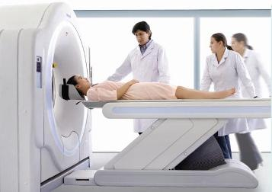
The image on the left is of the modern hospital equipment which public hospitals have,
It shows the cleanliness of the equipment supplied
Advanced state of the art setup.
Because of the advanced equipment patience are able to receive medical care in a more effective and efficient way.
As seen within the image on the above, you can see the problems in hospitals in poorer countries across the globe.
Lack of equipment
Lack of cleanliness
Lack of space.
Because of these errors, it causes majority of patience to pass away, due to little amount of medicines and professional stuff.

